Slide 1

CAPSTONE PROJECT
Medical Inventory System and Infrastructure

Slide 2
OBJECTIVES
Easy to access on all the Departments and Servers.
Better Network Connectivity.
Smooth Workflow.
Efficient and user friendly.
Enhance security.

Slide 3
REQUIREMENTS
Virtual Personal Computers(VPC) – To represent Departments
Ethernet Switches
Routers
Software-based Firewalls(Routers)
Web Server
Database Server

Slide 4
DESIGN CRITERIA
Each Departments are connected with each Ethernet Switch.
Database server and Web server are connected to one Ethernet switch.
Both Switches are connected to same Router for interconnecting.
To enhance the Security protocol firewall is implemented on all the Departments and both the Servers.
The Router is connected to the Internet.

Slide 5
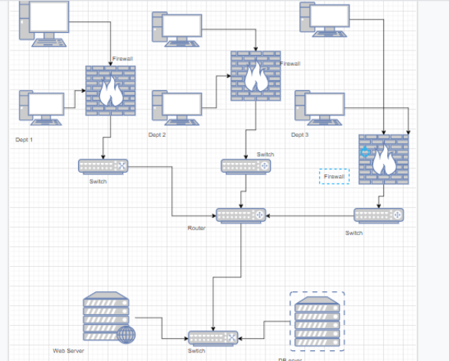
NETWORK DESIGN DRAW.IO

Slide 6
IP IMPLEMENTATION
For the Department 1 the IP is 192.168.1.10 and Gateway is 192.168.1.1.
For the Department 2 the Range of IP is 192.168.2.10 and Gateway is 192.168.2.1.
For the Department 3 the Range of IP is 192.168.3.0 and Gateway is 192.168.3.1.
Web Server IP is 192.168.6.10.
Database Server IP is 192.168.6.20.

Slide 7
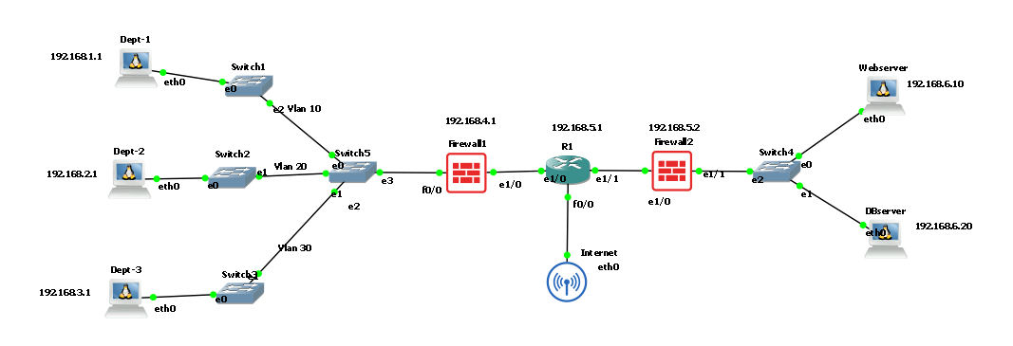
NETWORK DESIGN GNS3

Slide 8
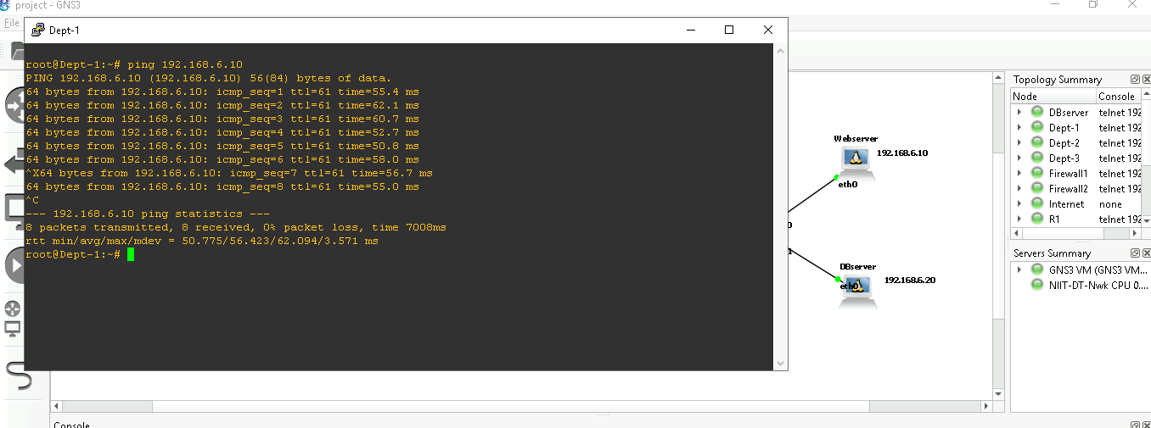
Connecting to WebServer

Slide 9
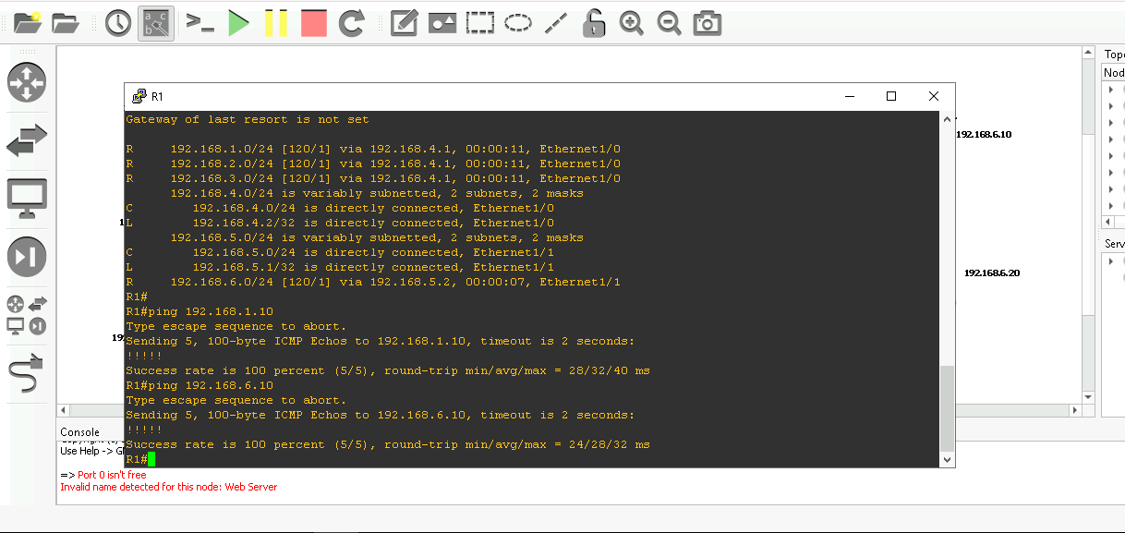
R1 Connecting

Slide 10
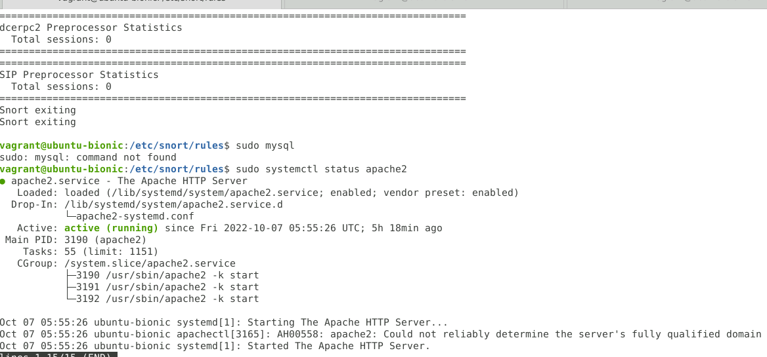
Web Server

Slide 11
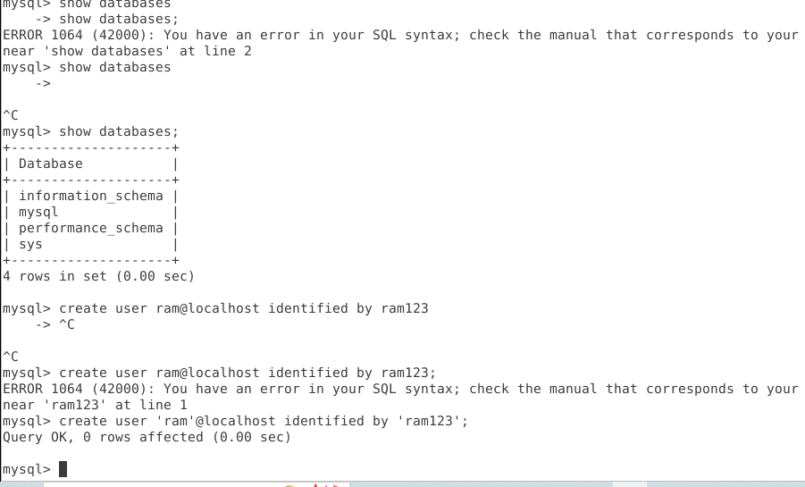
DB Server

Slide 12
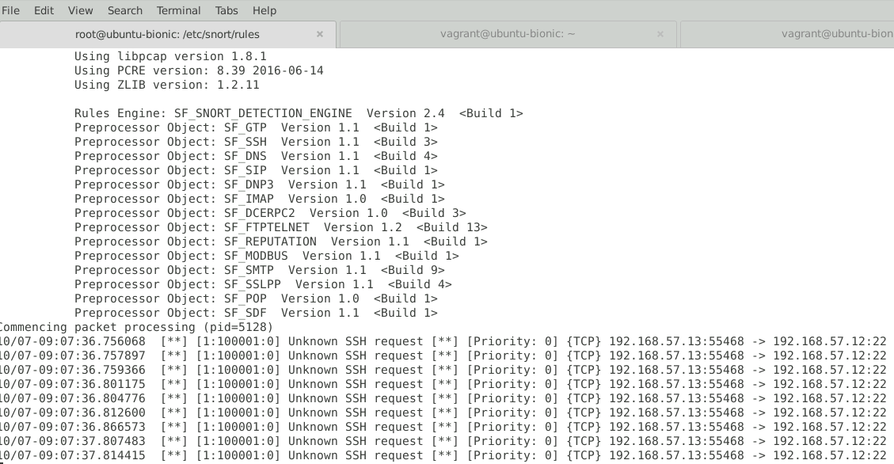
Snort -ssh

Slide 13
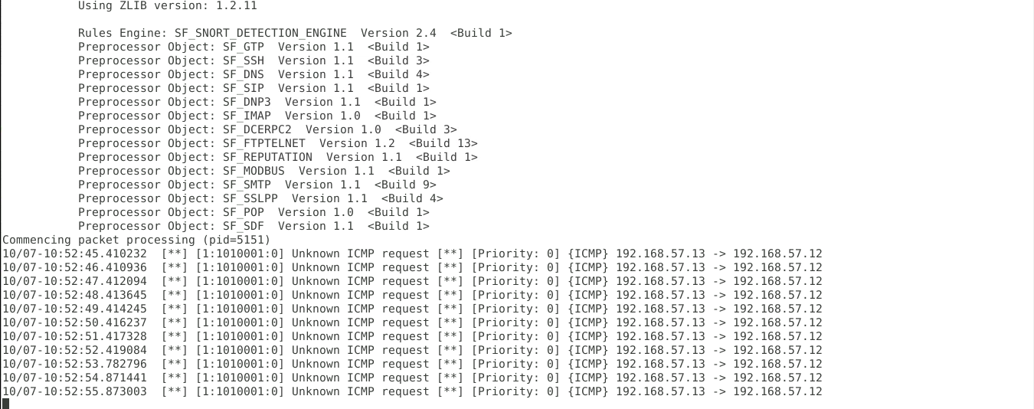
Snort-ICMP

Slide 14
THANK YOU

